Slide 1
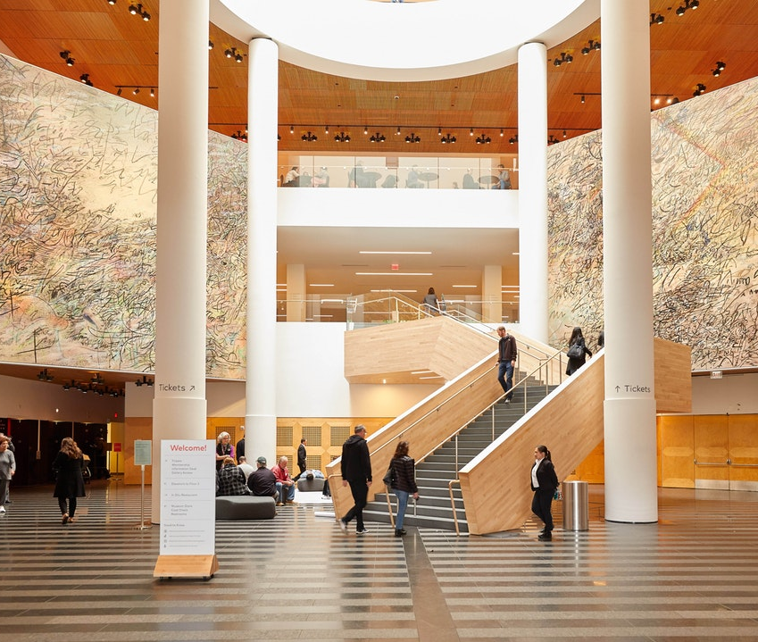
THE ART GALLERY TRACKING SYSTEM PROJECT
Team: Hawkgirl
TRAM ngoc LE (Jennie)
Bao Ngoc Dinh (Jane)
Annuo qian (Alice)
Haoyan ou (Amy)

Slide 2
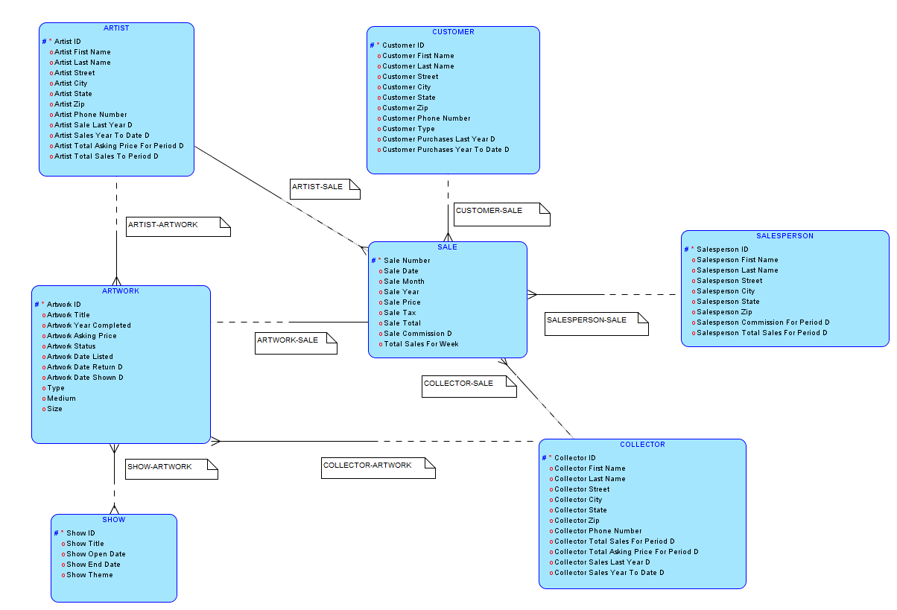
The Art Gallery Tracking System Entity Relationship Model

Slide 3
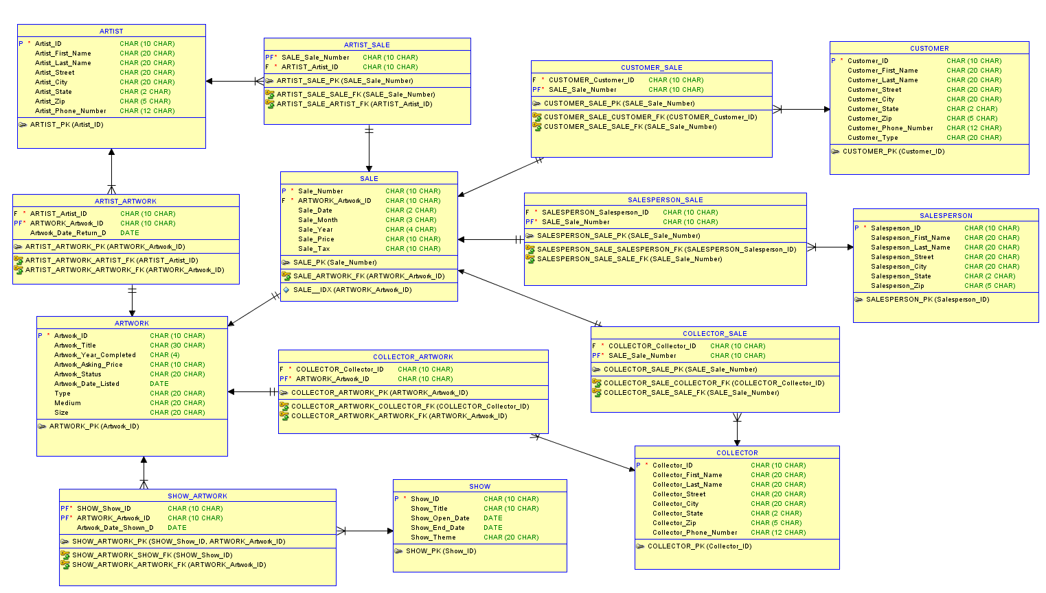
The Art Gallery Tracking System Normalized Relational Model

Slide 4
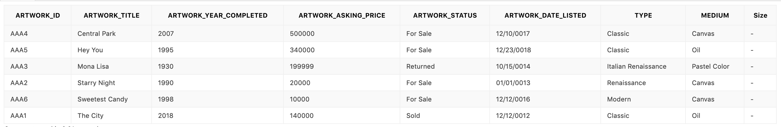
ARTWORK TABLE

Slide 5
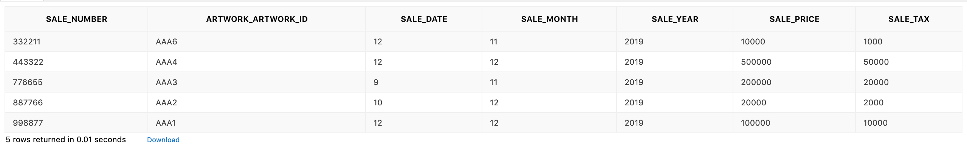
SALE TABLE

Slide 6
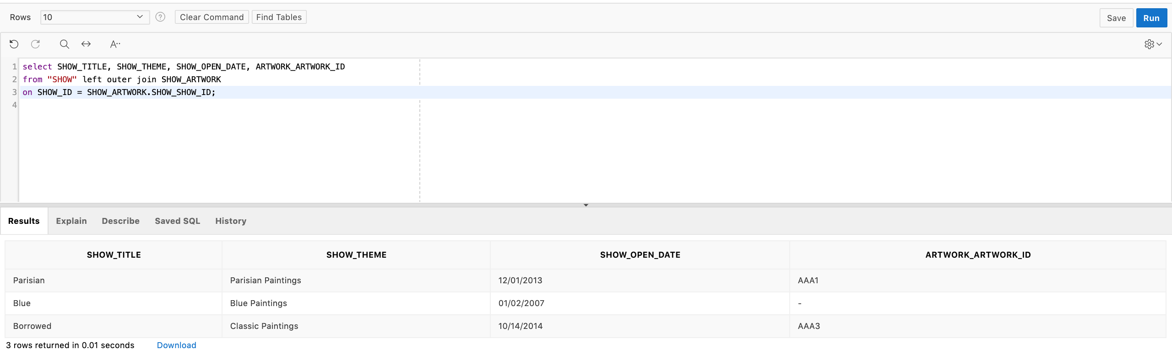
QUERY 1: List the show title, show theme, show open date, and the artwork ID in the show by combining SHOW and SHOW_ARTWORK tables from left to right

Slide 7
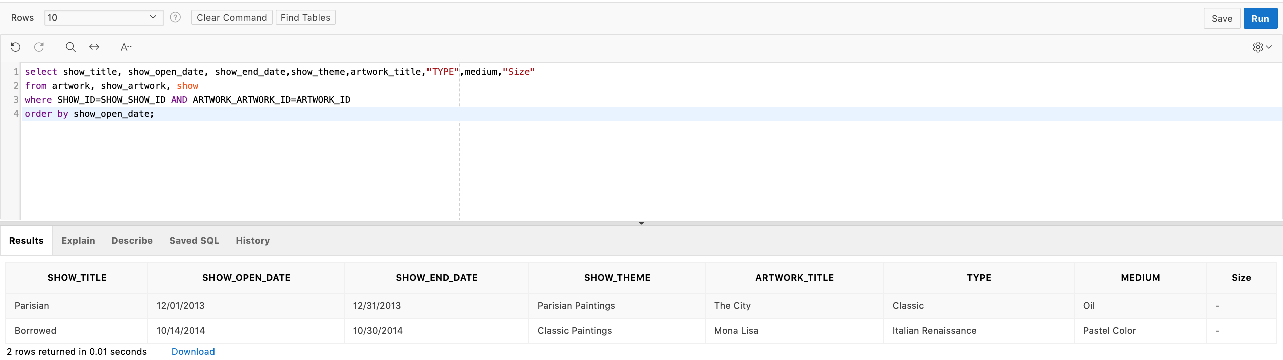
QUERY 2:Find all information on the shows the museum has run, their open and end date, theme, artworks that were showcased and their type, medium and size

Slide 8
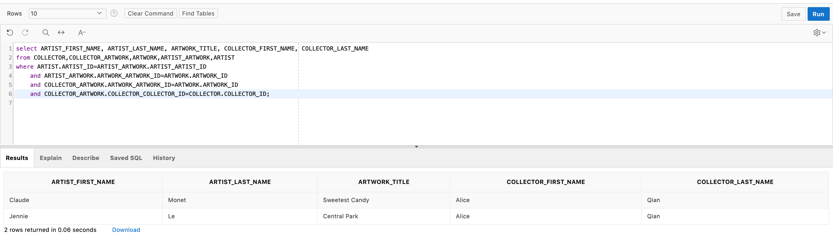
QUERY 3: List the artwork that is created by an artist and currently owned by one of the collectors

Slide 9
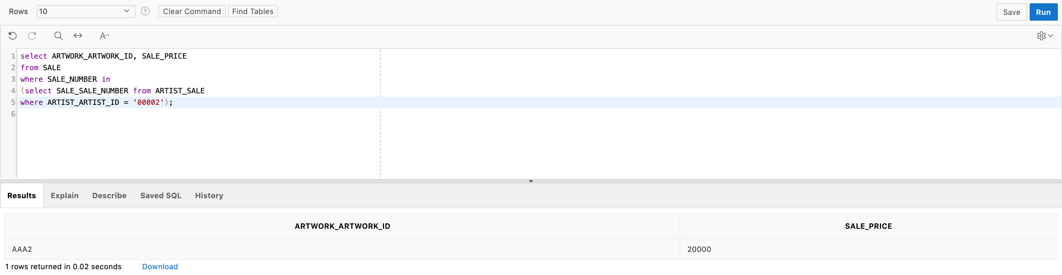
QUERY 4: List the IDs of all artworks, which belong to an artist with ID 00002, and the sale prices of those artwork whenever they were sold

Slide 10
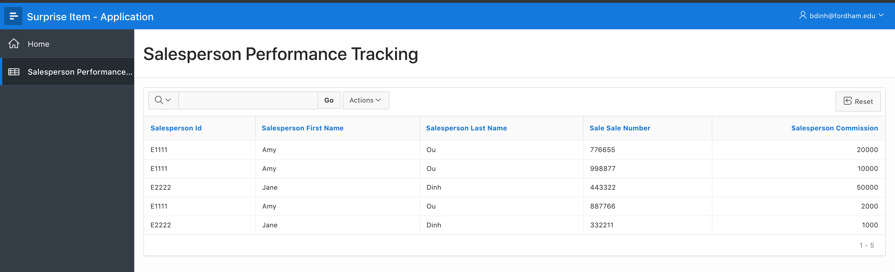
Database Application – How to generate a report to track sale performance?

